Slide 1

<<Email Classification>>
Group no. 1
Team Members: Shantanu Deshmukh, Amit Divekar, Hardik Suresh Vora, Bhushan Mahajan
Mentors: Karthik and Parth
22/05/2020

Slide 2
Business Problem:
Classification of Emails
Objective:
Inappropriate emails would demotivates and spoil the positive environment that would lead to more attrition rate and low productivity and Inappropriate emails could be on form of bullying,racism,sexual favourism and hate in the gender or culture,in todays world so dominated by email no organization is immune to these hate emails.
-The goal of the project is to identify such emails in the given day based on the above
inappropriate content.

Slide 3
Project Architecture / Project Flow
Milestone | Duration | Task start - End Date
Kick off and Business Objective discussion | 1 day | 27/04/2020
Data set Details | 1 Week | 27/04/2020-03/05/2020
EDA | 1 Weeks | 04/05/2020-10/05/2020
Model Building | 1 Week | 11/05/2020-17/05/2020
Model Evaluation | 1 Week | 17/05/2020-22/05/2020
Feedback
Deployment
Final presentation | 1 day

Slide 4
Exploratory Data Analysis (EDA) and
Feature Engineering

Slide 5
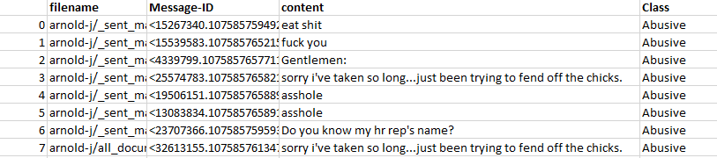
Data set details
Textual Data:
No of Rows & Columns : [48076,4]
Unique no of rows and columns :[24656,4]
Null values : 0

Slide 6
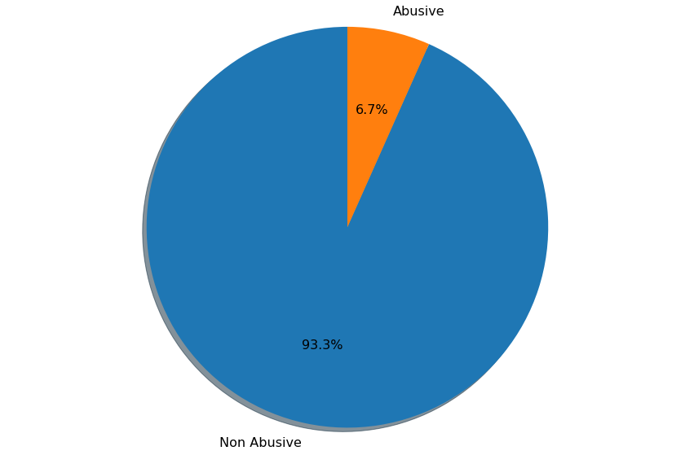
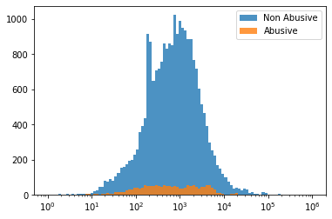
Exploratory Data Analysis (EDA)
Non Abusive data:93.3% , Abusive data:6.7%
Data Distribution:

Slide 7
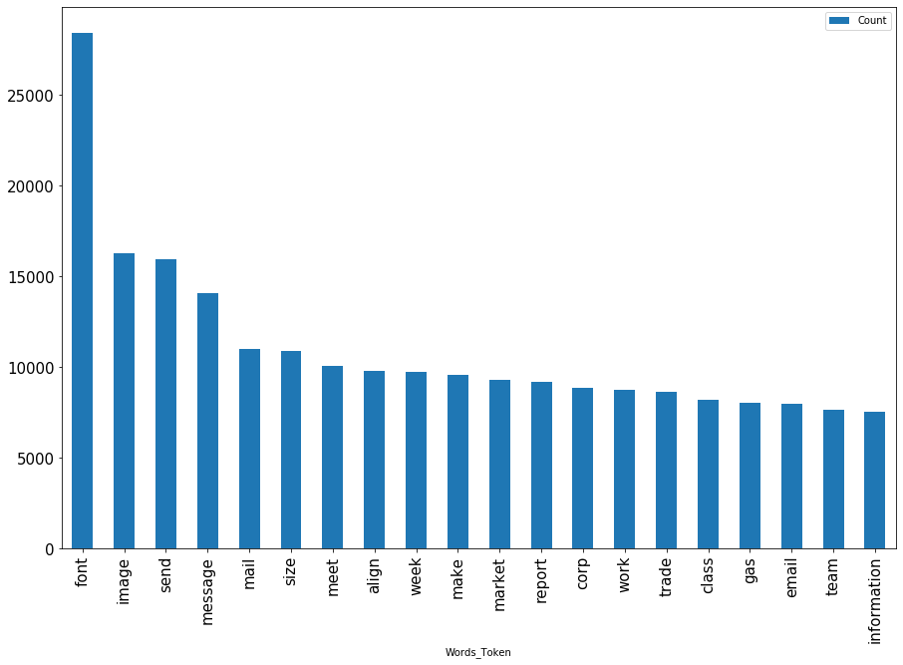
Exploratory Data Analysis (EDA)
Barplot for words with high frequency after data cleaning

Slide 8
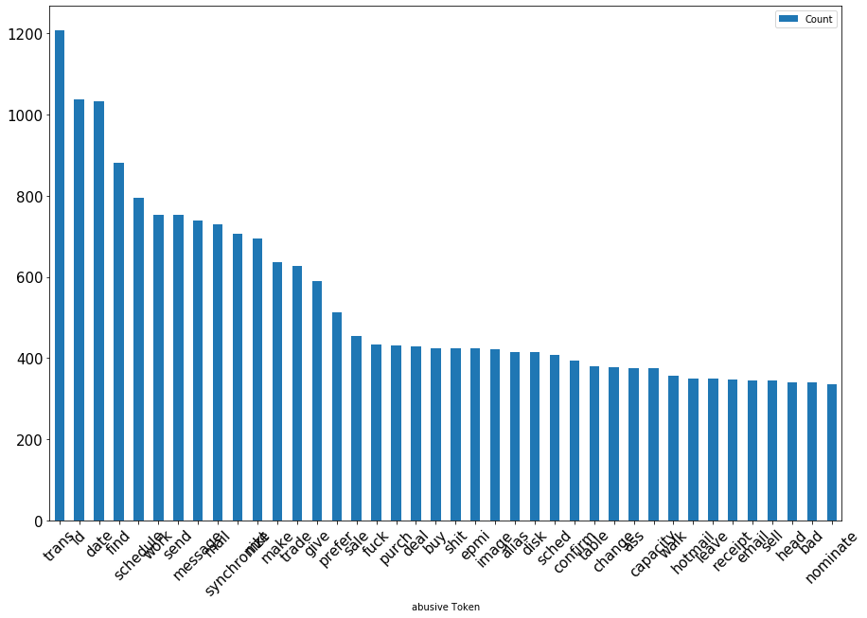
Exploratory Data Analysis (EDA)
Barplot for Abusive data

Slide 9
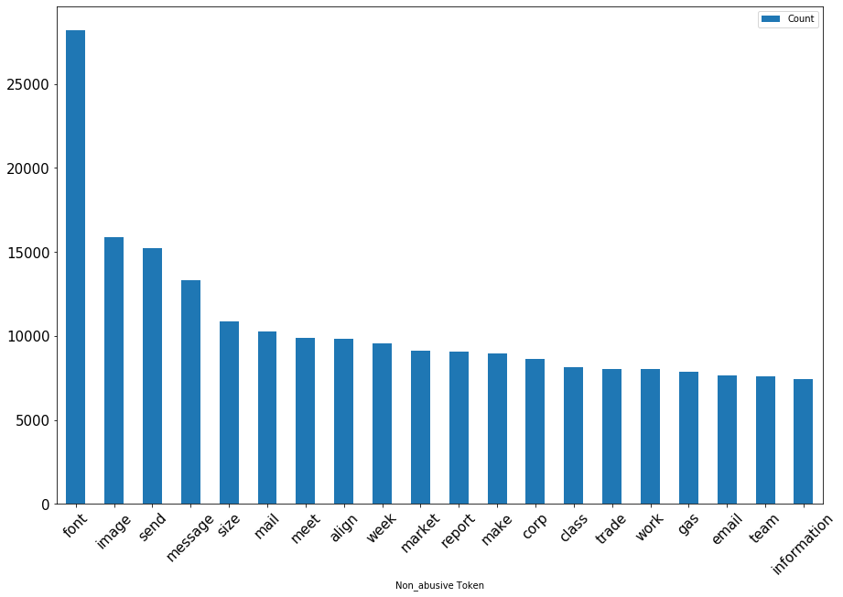
Exploratory Data Analysis (EDA)
Barplot for Non Abusive data

Slide 10
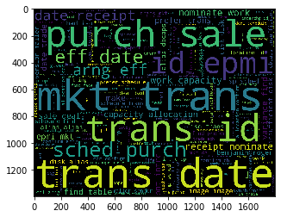
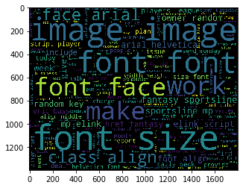
Exploratory Data Analysis (EDA)
Wordcloud for Abusive data Wordcloud for non Abusive data

Slide 11
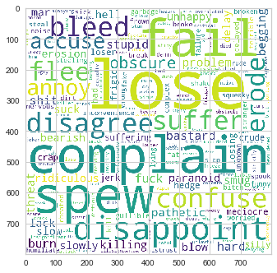
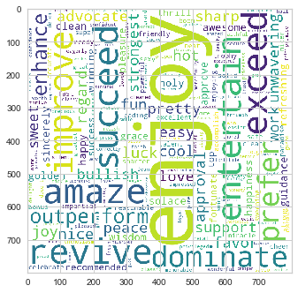
Exploratory Data Analysis (EDA)
Negative Wordcloud Positive Wordcloud

Slide 12
Feature Engineering
CountVectorizer:
Used to transform mail content data numerically like one hot coding.
TF-IDF transformer:
Used to computes tf-idf weights from a document-term matrix of token counts from mail content data.

Slide 13
Model Building

Slide 14
Model results
Model - SVM
Algorithms:
SVC (Support Vector Classification)
Data set details:
Size = 24656
Bag of Words Size = 103816
Algorithm details and configuration:
Hyper parameters:
kernel = Linear
C = 10
Loss= squared_hinge
penalty= l2
Data Partition details:
Training Set= 70 %( 17259)
Test Set = 30% (7397)
 | Before SMOTE | After SMOTE | With SMOTE and Tuned parameter
Accuracy | Training: 99.548 Test: 97.796 | Training: 99.784 Test: 97.444 | Training: 99.784 Test: 97.688
Recall | Abusive: 0.65 Non Abusive: 1.00 | Abusive: 0.77 Non Abusive: 0.99 | Abusive: 0.73 Non Abusive: 0.99
Precision | Abusive: 0.93 Non Abusive: 0.98 | Abusive: 0.78 Non Abusive: 0.99 | Abusive: 0.83 Non Abusive: 0.98
F1 score | Abusive: 0.77 Non Abusive: 0.99 | Abusive: 0.77 Non Abusive: 0.99 | Abusive: 0.78 Non Abusive: 0.99

Slide 15




Model Results
Confusion Matrices
Without SMOTE
With SMOTE
With SMOTE and tuned
Hyper-Parameters
Final Model Results (with all data)
Accuracy | 99.993
Recall | Abusive: 1.00 Non Abusive: 1.00
Precision | Abusive: 1.00 Non Abusive: 1.00
F1 score | Abusive: 1.00 Non Abusive: 1.00
Confusion Matrix

Slide 16
Model Deployment using Flask
model.py —Code for the machine learning model to classify mails.
app.py — Flask APIs that receives mail through GUI or API calls, provide class of mail based on our model and returns it.
request.py — Uses requests module to call APIs defined in app.py and displays the returned value.
HTML/CSS —HTML template and CSS styling to allow user to enter mail and displays the class.

Slide 17
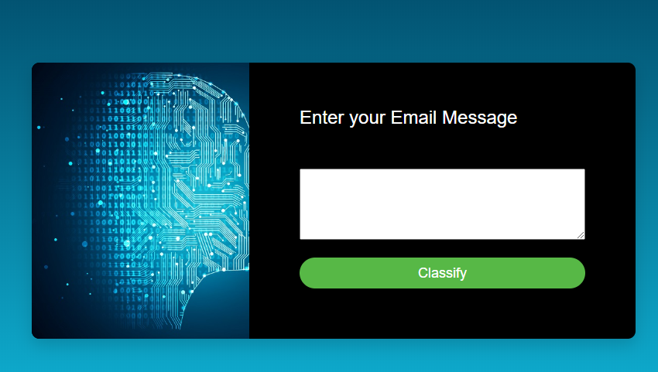
Model Deployment
Link :
https://emailclassification.herokuapp.com/

Slide 18
Challenges faced?
Bag of Words formation
Soln: By plotting most common words & if not meaningful add those to stopwords
Imbalanced data
Soln: Used SMOTE method to balance the data & train model
Model Accuracy
Soln: To achieve the highest accuracy used hyperparameter optimization method for SVM

Slide 19
Thank you

